Slide 1


SQL
Analysis on Banking Financial Transactions
@shreya_sonalinkedrnc

Slide 2
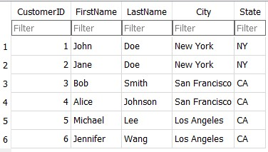

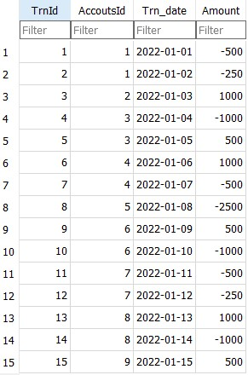
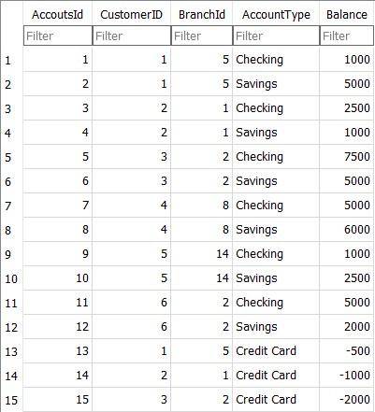
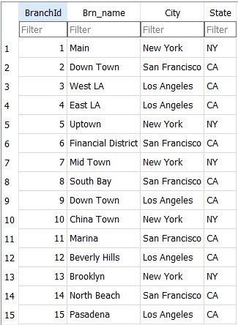
SQL
Table
@shreya_sonalinkedrnc

Slide 3


SQL
Write down the full name of customers with last name as 'Doe'.
Full_name
John Doe
Jane Doe
@shreya_sonalinkedrnc

Slide 4

SQL
What is the total number of accounts with respect to different account types in the accounts table?
AccountType | CountId
Checking | 6
Credit Card | 3
Saving | 6
@shreya_sonalinkedrnc

Slide 5

SQL
What is the total balance of all checking accounts?
AccountType | Bal
Checking | 22000
@shreya_sonalinkedrnc

Slide 6

SQL
What is the total balance of all accounts associated with customers living in 'Los Angeles'?
City | TotalBal
Los Angeles | 10500
@shreya_sonalinkedrnc

Slide 7

SQL
Which branch has the highest average account balance?
Brn_name | High_avg_accbal
Main | 833.33
@shreya_sonalinkedrnc

Slide 8

SQL
Count the branches and total balance all together where branch named as 'Town'.
Branch | total
8 | 23000
@shreya_sonalinkedrnc

Slide 9

SQL
Which 3 customers has the highest current balance in their account?
Full_name | high_bal
Bob Smith | 7500
Alice Johnson | 6000
John Doe | 5000
@shreya_sonalinkedrnc

Slide 10
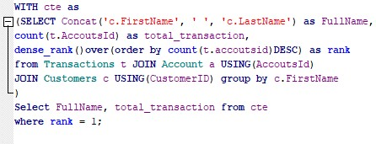
SQL
Which customer has made the most number of transactions?
FullName | total_transactions
Jane Doe | 4
Alice Johnson | 4
@shreya_sonalinkedrnc

Slide 11

SQL
Which branch has the highest total balance across all the account?
Brn_name | total_bal
Down Town | 17500
@shreya_sonalinkedrnc

Slide 12

SQL
Which customer has the highest total balance across all the accounts, including savings and checking account?
First_name | total_bal
Bob | 12500
@shreya_sonalinkedrnc

Slide 13
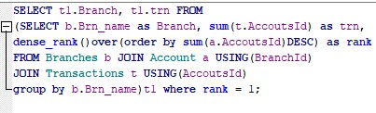
SQL
Which branch has the highest number of transactions in the transaction table?
Branch | trn
South Bay | 30
@shreya_sonalinkedrnc

Slide 14

SQL
Give me the customer names whose transactions are done on Even no. of days?
FirstName
John
Jane
Bob
Alice
@shreya_sonalinkedrnc

Slide 15
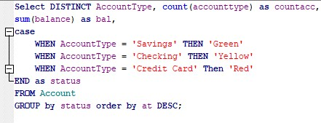
SQL
Give me the name and number of account type also total balance in each account type with respect to their status mentioning savings as green, checking as yellow and credit card as red.
AccountType | countacc | bal | status
Checking | 6 | 22000 | Yellow
Savings | 6 | 21500 | Green
Credit Card | 3 | -3500 | Red
@shreya_sonalinkedrnc

Slide 16
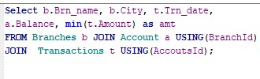
SQL
Which branch of which city had the minimum transaction amount on which transaction date and what is the balance maintained in the account?
Brn_name | City | Trn_date | Balance | amt
Down Town | San Francisco | 2022-01-08 | 7500 | -2500
@shreya_sonalinkedrnc

Slide 17

SQL
Show me the customers with their balance which is more than their average
balance?
FirstName | Balance
Bob | 7500
John | 5000
Jennifer | 5000
Alice | 5000
@shreya_sonalinkedrnc

Slide 18
SQL
Thank You
for your patience!!
@shreya_sonalinkedrnc

